Slide 1
Final Year Project
Robert James Gabriel
Notes:
Add web d

Slide 2
Developing a web browser and Chrome extension with on the fly filtering and parent-child monitoring
using machine learning algorithms, Node.js and Nw.js

Slide 3
Intro
Develop a web browser using Node.js Webkit with a built in filtering system to block content that the parent wouldn't want their child to access.

Slide 4
What I'm trying to solve
Filtering systems give false positives, where sites that are safe are blocked when they shouldn't be.
Most sexual education sites are blocked as they use sexual words.

Slide 5
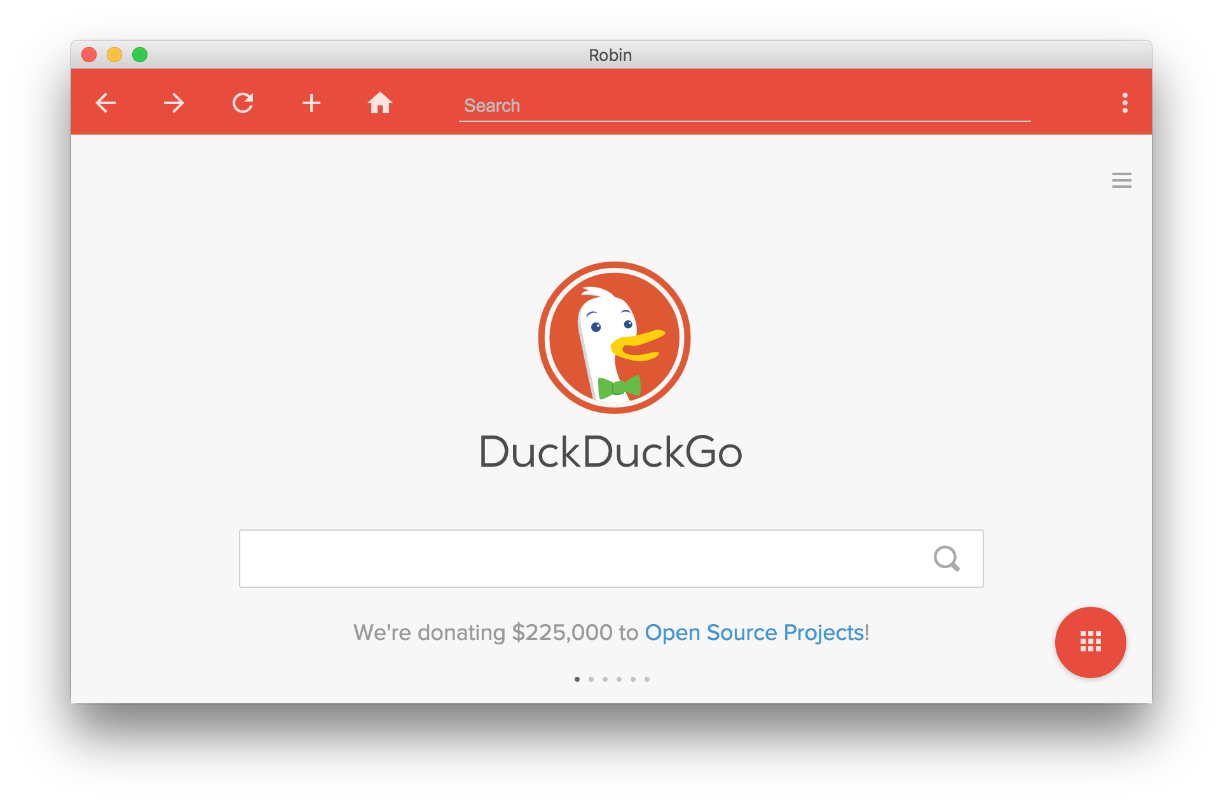
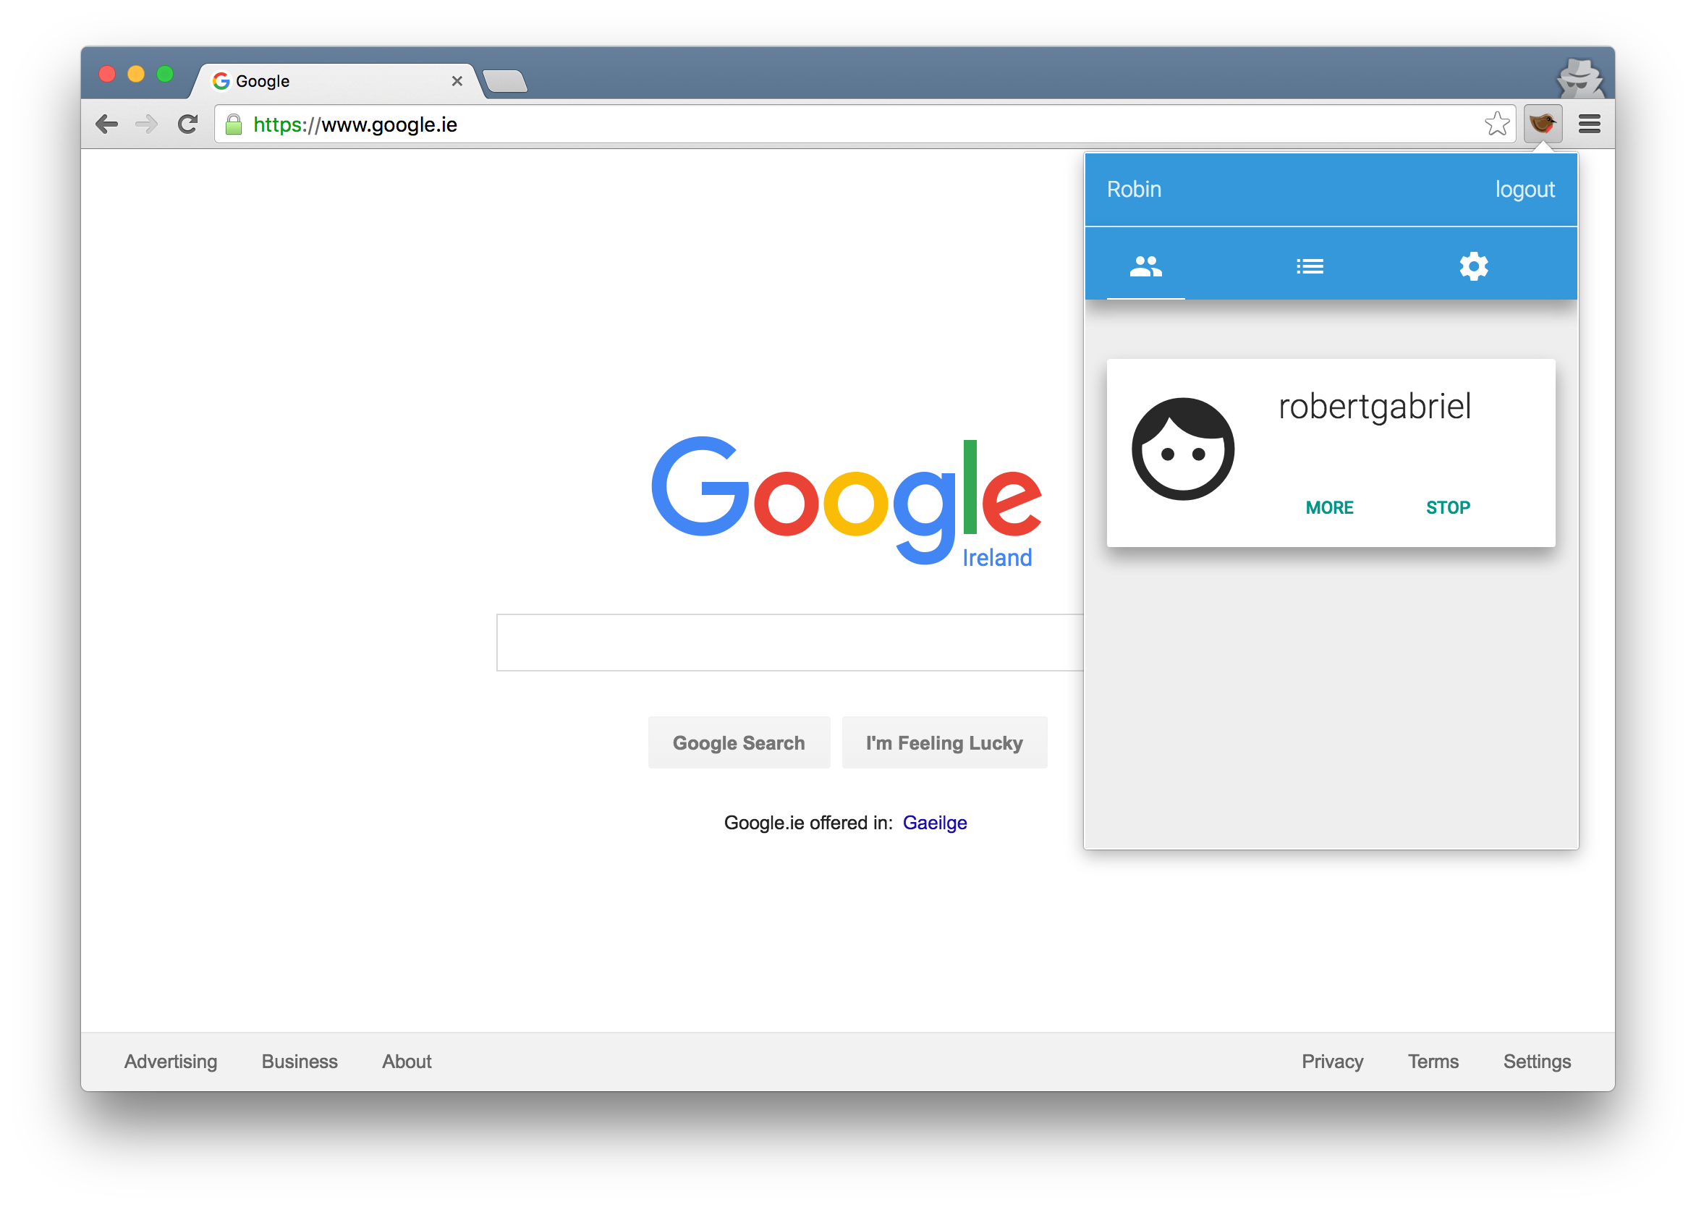


Web Browser
Chrome Extension
Built using Angularjs mvc pattern

Slide 6
Web Browser
Features
Refresh page
Create/delete tabs
View tabs
Go Forward/Back
Go Home
Search the web
Change the theme

Slide 7











Web Browser
Built with

Slide 8
Chrome Extension
Features
Set Blacklist sites
Set Whitelist Sites
Personal settings
Monitor what users are on
Stop access to the web.

Slide 9
Chrome Extension
Built with

Slide 10
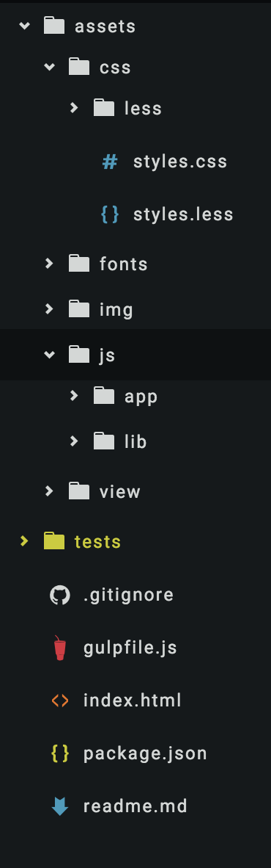
Designs
Built using Material design guidelines
Uses gulp.js for compiling and building scripts.
Shares a Code base.
Uses the Angular.js Mvc Pattern

Slide 11
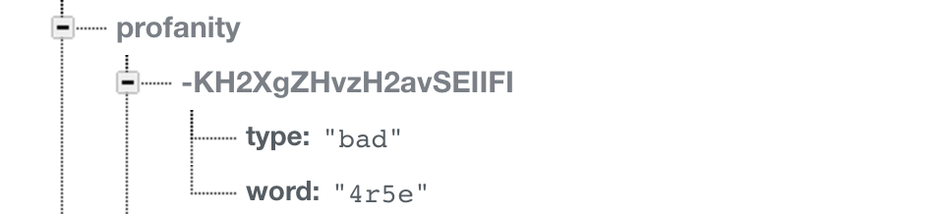
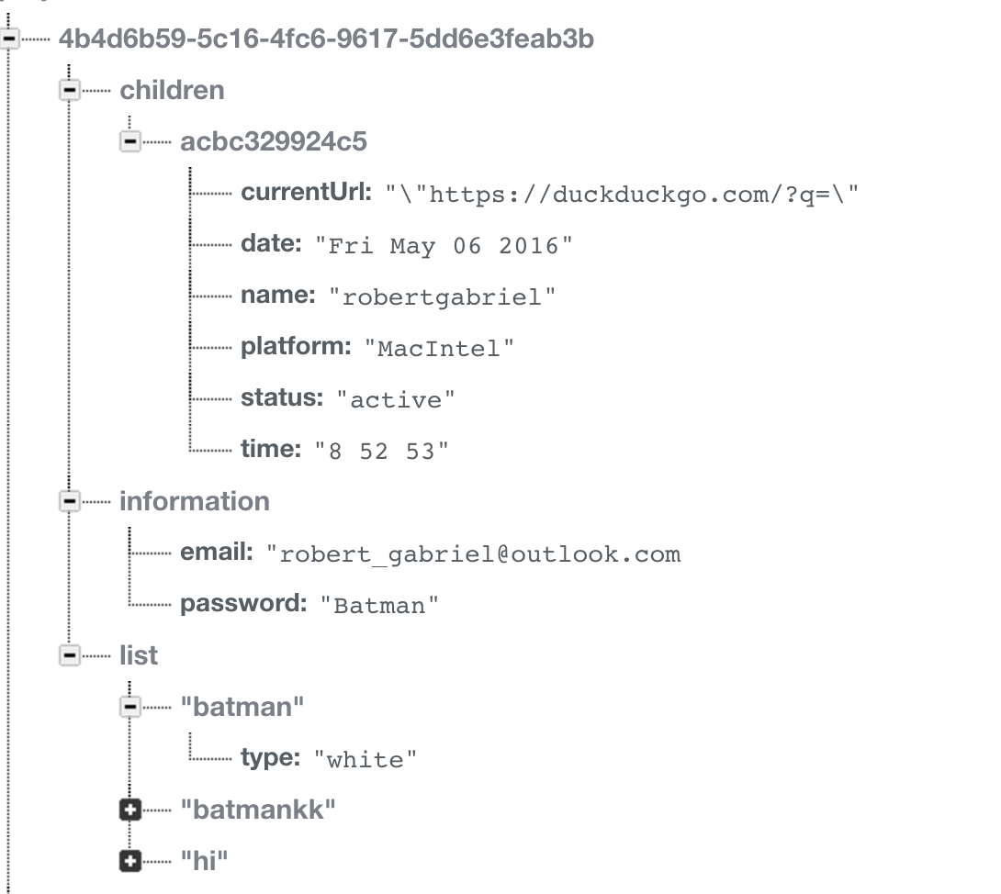
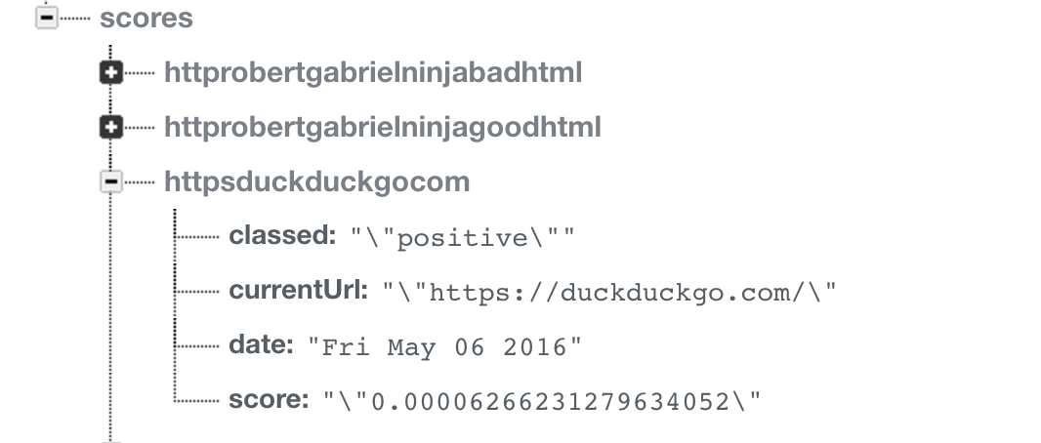
Firebase Structures
Notes:
Learns words, didnt get training data, this is the design , model -> feed data unknown result.

Slide 12
Filtering System
Parser
Verb Checker
Profanity Checker
Made up of

Slide 13
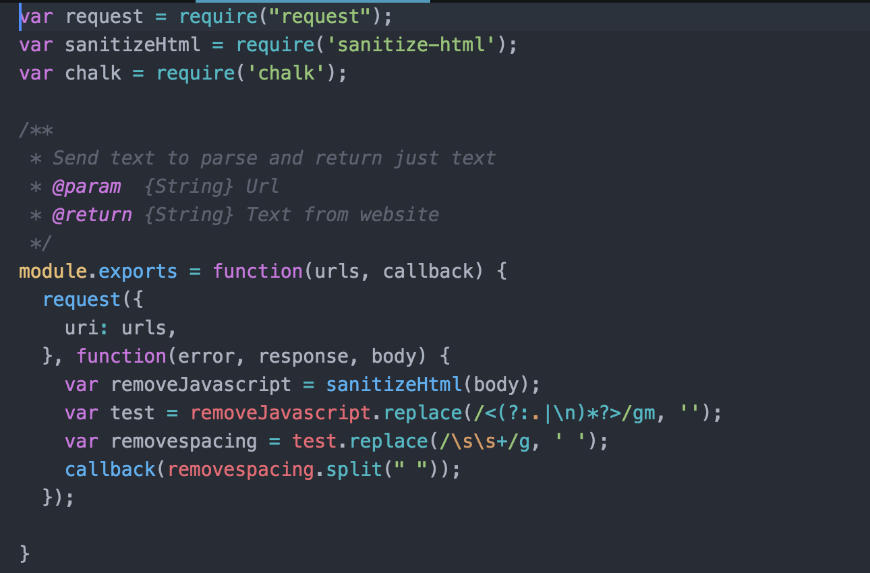
Parser
HTML parsing removes all javascript,css & html from web pages.
Leaving just text.

Slide 14
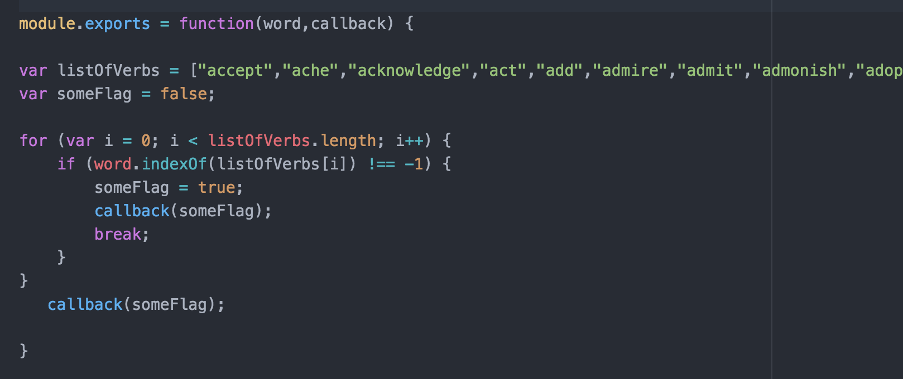
Verb Checker
The verb checker, checks if I given word is a verb of not.
It uses the collection from for direcoty.com and the firebase database.

Slide 15
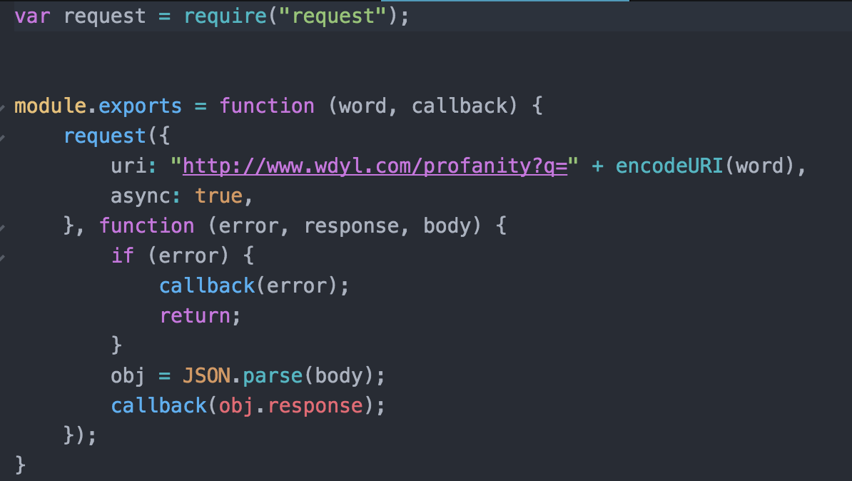
Profanity Checker
Checks each word to see if it's classified as profanity or not.
Checks of Google Profanity Api
This allows the collection negative & positive words.

Slide 16
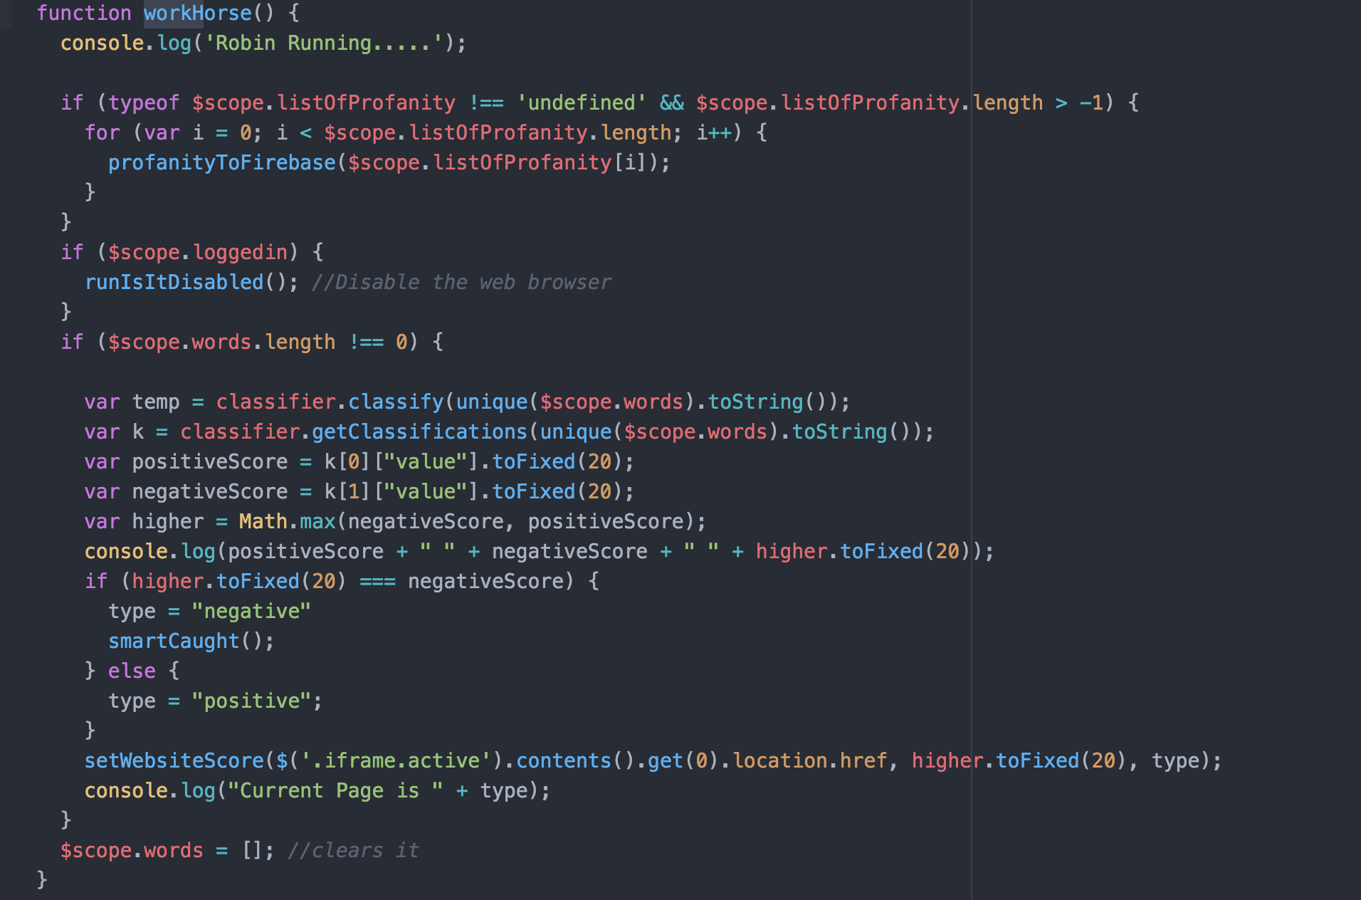
WorkHorse
WorkHorse are used for large processing data or tasks.
Such as if a website has thousands of words.
It will be put into a list and the workhorse will deal with in the background every 5 seconds.
The verb check, parser , profanity check all run within the workhorse.

Slide 17
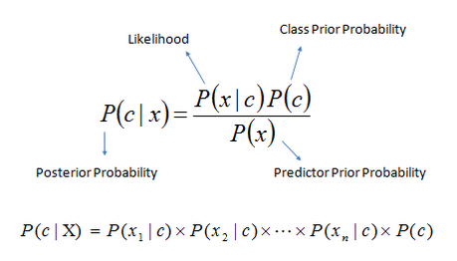
Native Baylor Algorithm
The negative & positive words we store on firebase as training data.
When a user visits a new website, after the parsing.
Array of words are place, to see if the text on the webpage classifies as negative or positive.

Slide 18
Native Baylor Algorithm
Example of training Data
Good Words: [ "the","of","and","to","a","in""]
Negative Words: ["4r5e","5h1t","5hit","a55","ar5e"]
It's weighted at 75/25 (negative/positive).

Slide 19
Testing & Results
Stress & Load testing
Regression Testing
Boot necking/freezing with loading the 14,000 datasets.
Loading 1,000 datasets every 5 seconds removing strain on the application and decreasing training time.
Was used to ensure any updates to code didn't break anything
This was automated using gulp.js.

Slide 20
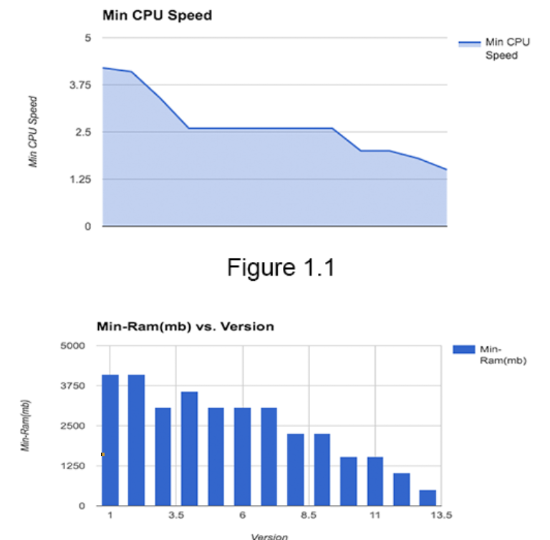
Testing & Results
Performance testing
There was 13 version of the application.
Each version was
monitored for performance issues
optimizing code & resources.

Slide 21
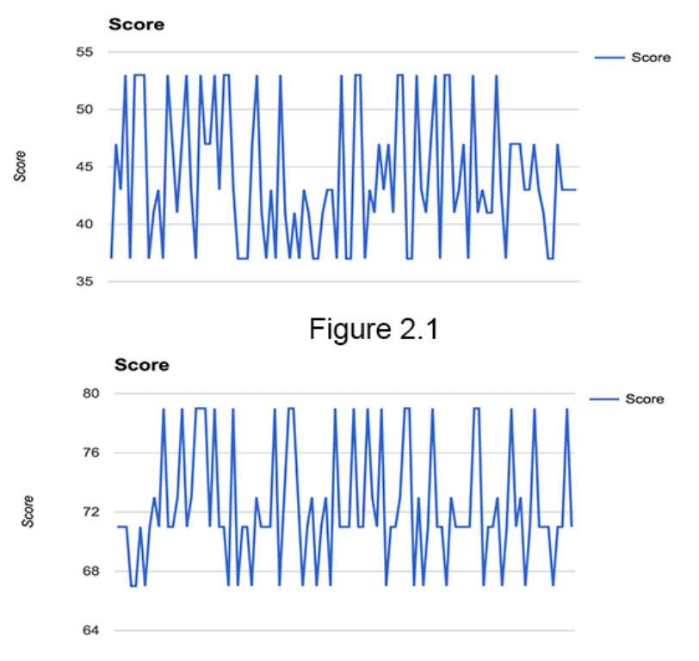
Testing & Results
Accuracy testing
The accuracy of the Naive Bayes classifier was 50% with 50/50 negative positive words.
After analyzing the data, having the positive words to a weight of 75/25 gave results of 70% - 80%.
The reason is that the positive and negative words both appear in adult sites.

Slide 22
Conclusion
MVC patterns is deal for web apps that need to be scalable / individual parts.
Halving the positive over negative words was achieving a result of 70/80%
Positive and negative words both appear in adult sites.
The use of a workhorse for processing large data is amazing to relieve strain
•Further study into this area of word analytics for websites.

